Slide 1
Introduction to Database
1-96
CHAPTER 6
Database Design and the E-R Model
Entity Sets
Relationship Sets
Design Issues
Mapping Constraints
Keys
E-R Diagram
Extended E-R Features
Design of an E-R Database Schema
Reduction of an E-R Schema to Tables
6-<number>

Slide 2
PART 2: DATABASE DESIGN
Database Design and the E-R Model (Chapter 6)
  Database Design
  Using E-R Model
Relational Database Design (Chapter 7)
  Logical Database Design
  Normalization
Application Design and Development (chapter 8)
  User Interface
  Web Interface
  Authorization
  Security
  …
6-<number>

Slide 3
6.1 Overview of the Design Process
Database Application System:
  A complex task
    Design database schema
    Design programs
    Design security schemes
    …
Design Phases:
  Requirements: user needs vs. domain experts
  Conceptual Design
  Specification of functional requirements
  Logical database design
  Physical database design
Avoid
  Redundancy
  Incompleteness
慨念
6-<number>
Notes:
?domain experts

Slide 4
6.2 The E-R Model
A database can be modeled as:
  A collection of entities (objects), e.g. Students, Department
  Relationship among entities (objects), e.g. Major-In
    E.g. Joni major-in IM
Entity-Relationship (E-R) Data Model:
  Entity sets
  Relationship sets
  Attributes
Semantic Data Model:
  Representation of the meaning of the data
  Mapping the real-world enterprise onto a conceptual schema
  E.g. Fig. 6.25: E-R diagram for a banking enterprise, p.240
語义
慨念
6-<number>
Notes:
?

Slide 5




Real-world vs. E-R Model vs. Tables
The real-world enterprise
Semantic Data Model:
Entity-Relationship (E-R) Data Model
1. branch
2. customer
3. depositor
分公司
客戶(存款戶,貸款戶)
存款戶
6-<number>

Slide 6
E-R Diagram for a Banking Enterprise, p.240
6-<number>

Slide 7
Example: Banking Database
Banking Database: consists 6 relations:
  branch (branch-name, branch-city, assets)
  customer (customer-name, customer-street, customer-only)
  account (account-number, branch-name, balance)
  loan (loan-number, branch-name, amount)
  depositor (customer-name, account-number)
  borrower (customer-name, loan-number)
6-<number>

Slide 8



Example: Banking Database
1. branch
2. customer
3. depositor
分公司
客戶(存款戶,貸款戶)
存款戶
4. borrower
貸款戶
5. account
存款帳
6. loan
貸款帳
6-<number>

Slide 9

Example: Banking Database (cont.)
A Banking Enterprise
6-<number>

Slide 10
6.2.1 Entity Sets
A database can be modeled as:
  a collection of entities, and
  relationship among entities.
Entity:
  is an object that exists and
  is distinguishable from other objects.
    Example: each person in an company, loans, holiday, ..
  Entities have attributes
    person have names and addresses
Entity set:
  is a set of entities of the same type
  that share the same properties or attributes.
    Example: set of all persons who are customers at a given bank, can be defined as the entity set customer.
6-<number>

Slide 11
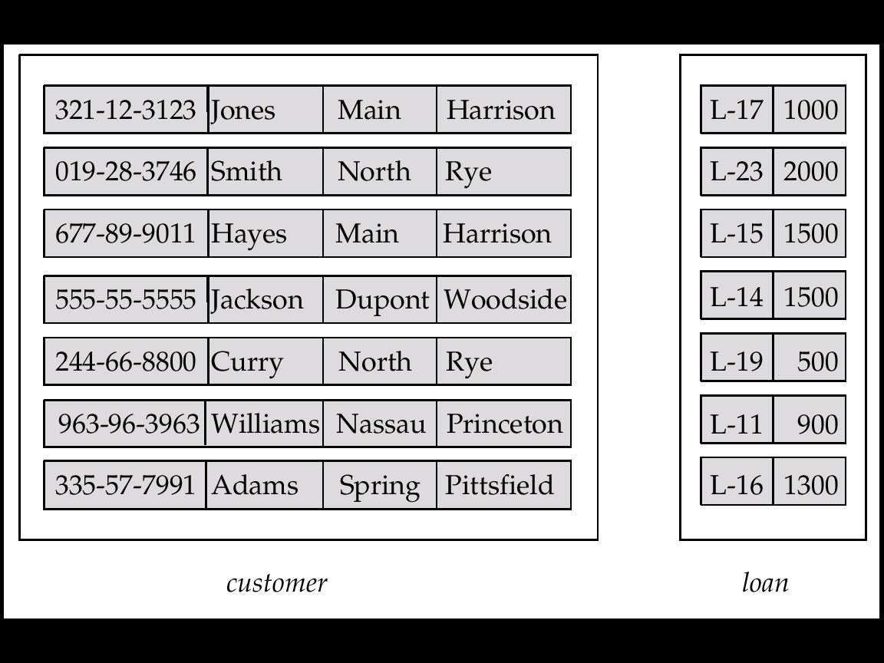
Entity Sets: Customer and Loan, Fig. 6.1
customer-id customer- customer- customer- loan- amount
name street city number
6-<number>

Slide 12
6.2.2 Relationship Sets
Relationship: is an association among several entities
  Example:
  Hayes depositor A-102
  customer entity relationship set account entity
存款戶/人
customer = (customer-id, customer-name, customer-street, customer-city)
account = (account-number, branch-name, balance)
customer
depositor
account
存款帳
客戶(存款戶,貸款戶)
存款戶
6-<number>

Slide 13
Relationship Sets (cont.)
Relationship Set:
  is a set of relationships of the same types, e.g. depositor
  Formally, is a mathematical relation among n ≥ 2 entities, each taken from entity sets E₁, E₂, …, E_{n},
  then a relationship set R is a subset of
{(e₁, e₂, … e_{n}) | e₁ ∈ E₁, e₂ ∈ E₂, …, e_{n} ∈ E_{n}}
where (e₁, e₂, …, e_{n}) is a relationship
  Example:
  (Hayes, A-102) ∈ depositor
4. depositor
Hayes ∈ ?
A-102 ∈ ?
6-<number>

Slide 14
E-R Diagram for a Banking Enterprise
6-<number>

Slide 15

Relationship Set: borrower
借款戶
6. borrower
借款戶
6-<number>

Slide 16

Relationship Sets (Cont.)
Relationship Set: can have attribute
  E.g. access-date is the attribute of depositor
depositor
access-date
6-<number>

Slide 17

Degree of a Relationship Set
Degree of a Relationship Set: refers to number of entity sets that participate
  Binary Relationship : Relationship sets that involve two entity sets are binary (or degree two).
    Generally, most relationship sets are binary.
  N-nary Relationship : Relationship sets may involve more than two entity sets.
E.g. Ternary Relationship
Suppose employees of a bank may have jobs (responsibilities) at multiple branches, with different jobs at different branches.
Ternary relationship set between entity sets employee, job, and branch
Fig. 6.12
6-<number>

Slide 18
6.2.3 Attributes
Attributes: descriptive properties possessed by all members of an entity set.
  Example:
customer = (customer-id, customer-name, customer-street, customer-city)
loan = (loan-number, amount)
Domain – the set of permitted values for each attribute
Attribute types:
  Simple 简单 and composite 复合 attributes.
  Single-valued and multi-valued attributes
    E.g. Multivalued attribute: phone-numbers
  Derived派生 attributes
    Can be computed from other attributes
    E.g. age, given date of birth
6-<number>

Slide 19

Composite Attributes
Fig. 6.4
6-<number>

Slide 20
6.3 Constraints 约束
Constraints: the contents of a database must conform.
  E.g. balance > 0
  E.g. A customer must have one and only one account
  E.g. A customer can have more than one account
Mapping cardinality constraints 映射基数约束
Key constraints 键约束
Participation constraints 参与约束
一致, 規範, form
6-<number>
Notes:
?

Slide 21
6.3.1 Mapping Cardinalities
Express the number of entities to which another entity can be associated via a relationship set.
Most useful in describing binary relationship sets.
For a binary relationship set the mapping cardinality must be one of the following types:
  One to one
  One to many
  Many to one
  Many to many
6-<number>

Slide 22

Mapping Cardinalities (Cont.)
One to one
One to many
Note: Some elements in A and B may not be mapped to any
elements in the other set
6-<number>

Slide 23

Mapping Cardinalities (cont.)
Many to one
Many to many
Note: Some elements in A and B may not be mapped to any
elements in the other set
6-<number>

Slide 24
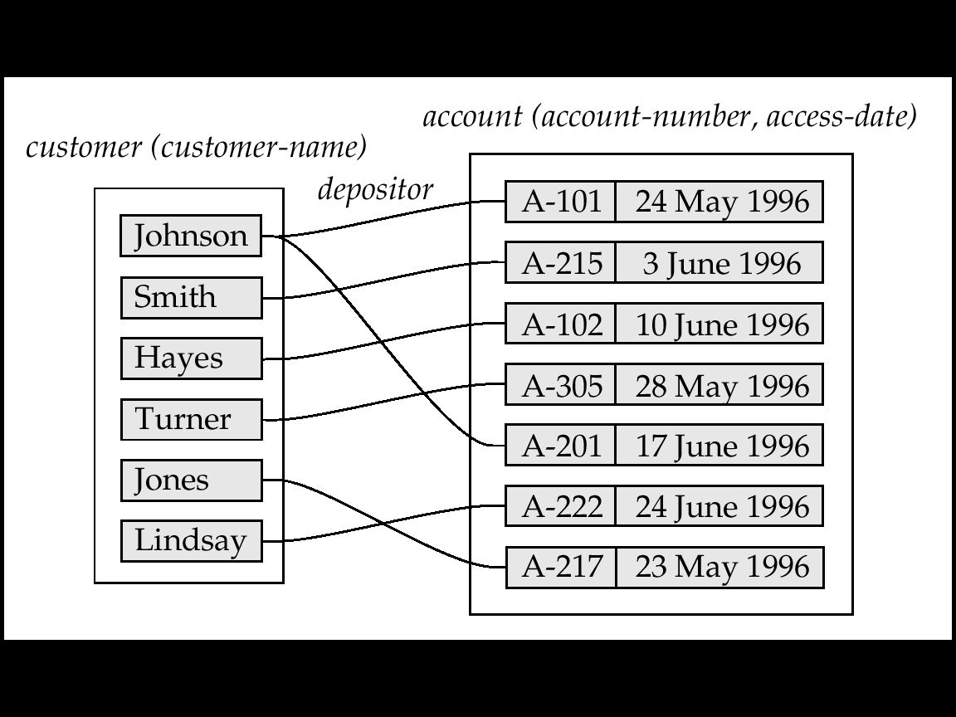
Mapping Cardinalities affect ER Design
If each account can have only one customer, we can make access-date an attribute of account, instead of a relationship attribute,
  i.e., the relationship from account to customer is many to one, or equivalently, customer to account is one to many
?
one to many vs. many to one
?
access-date
Semantic Meaning?
access-date
6-<number>

Slide 25
6.3.2 Keys
Entity Set are distinguished
  Individual entities are distinct
  Difference among entities must be expressed in terms of their attributes
  Uniquely identify the entity
Key
2. customer
id
6-<number>

Slide 26
6.3.2.1 Keys for Entity Sets
Super key: A super key of an entity set is a set of one or more attributes whose values uniquely determine each entity.
  E.g. id, id + customer-name, ?+?+?, …
Candidate key: A candidate key of an entity set is a minimal super key
  Customer-id is candidate key of customer
  Customer-name is candidate key of customer
2. customer
id
Primary key: Several candidate keys may exist, one of the candidate keys is selected to be the primary key.
  Need to consider semantics of relationship set in selecting
    Address vs. Social Security Number ➔ change often ?
6-<number>
Notes:
In selecting?

Slide 27

6.3.2.2 Keys for Relationship Sets
Super Key of a relationship set : The combination of primary keys of the participating entity sets forms a super key of a relationship set.
  (customer-id, account-number) is the super key of depositor
Ref, p.217
2. customer
4. depositor
3. account
id
id
6-<number>

Slide 28
Keys for Relationship Sets (cont.)
Candidate Keys of a relationship set : Must consider the mapping cardinality of the relationship set when deciding the what are the candidate keys
  Case 1: Many to one from customer to account
    Meaning: can have join account
    Key of depositor: is key of customer
  Case 2: One to many from customer to account
    Meaning: a customer can have many accounts
    Key of depositor: is key of account
  Case 3: One to one from customer to account
    Meaning: a customer must have one and only one account
    Key of depositor: either primary can be used
  Case 4: Many to many
    Meaning: a customer can have many accounts and join account
    Key of depositor: is key of customer UNION key of account
6-<number>
Notes:
Have join account? 联合账户？

Slide 29
Keys for Relationship Sets: Case 1
  Case 1: many to One from customer to account
    Meaning: can have join account
    Key of depositor: is key of customer
6-<number>

Slide 30
Keys for Relationship Sets: Case 2
  Case 2: One to many from customer to account
    Meaning: a customer can have many accounts
    Key of depositor: is key of account
1
n
6-<number>

Slide 31
Keys for Relationship Sets: Case 3
  Case 3: One to one from customer to account
    Meaning: a customer must have one and only one account
    Key of depositor: either primary can be used
6-<number>

Slide 32
Keys for Relationship Sets: Case 4
  Case 4: Many to many
    Meaning: a customer can have many accounts and join account
    Key of depositor: is key of customer UNION key of account
6-<number>

Slide 33
6.3.3 Participation Constraints
Total Participation 全部参与: e.g. loan
  The participation of loan in the relationship set borrow is total.
Partial Participation 部分参与: e.g. customer
customer
loan
E1
E2
E3
E4
.
.
.
.
.
.
.
Relationship Set: borrower
6-<number>

Slide 34

6.4 E-R Diagrams E-R图
E-R diagram:
  Can express the overall logical structure of a database graphically
  Simple and clear
Major components:
  Rectangles: represent entity sets.
  Diamonds: represent relationship sets.
  Lines: link attributes to entity sets and entity sets to relationship sets.
  Underline: indicates primary key attributes (will study later)
Fig. 6.7
6-<number>

Slide 35

Fig.6.10 Composite, Multivalued, and Derived Attributes
E-R Diagrams (cont.)
Major components: (cont.)
  Ellipses: represent attributes
    Double ellipses represent multivalued attributes.
    Dashed ellipses denote derived attributes.
Composite
6-<number>

Slide 36

E-R Diagrams: Cardinality Constraints
Express cardinality constraints
  directed line (→), signifying “one” or
  A undirected line (—), signifying “many”
E.g.: One-to-one relationship:
  A customer is associated with at most one loan via the relationship borrower
  A loan is associated with at most one customer via borrower
1
1
Fig. 6.8(c)
6-<number>

Slide 37
One-To-Many Relationship, Fig. 6.8(a)
In the one-to-many relationship a loan is associated with at most one customer via borrower, a customer is associated with several (including 0) loans via borrower
1
n
6-<number>

Slide 38
Many-To-One Relationships, Fig. 6.8(b)
In a many-to-one relationship a loan is associated with several (including 0) customers via borrower, a customer is associated with at most one loan via borrower
n
1
6-<number>

Slide 39
One-To-One Relationships, Fig. 6.8(c)
E.g.: One-to-one relationship:
  A customer is associated with at most one loan via the relationship borrower
  A loan is associated with at most one customer via borrower
1
1
Fig. 6.8(c)
6-<number>

Slide 40
Many-To-Many Relationship
n
n
A customer is associated with several (possibly 0) loans via borrower
A loan is associated with several (possibly 0) customers via borrower
6-<number>

Slide 41
Relationship Sets with Attributes, Fig. 6.9
Attributes can be attached to a relation set
E.g. Attribute access-date is attached to depositor
6-<number>

Slide 42

Role Indicator 角色标识, Fig. 6.11
Roles are indicated in E-R diagrams by labeling the lines that connect diamonds to rectangles.
Entity sets of a relationship need not be distinct
The labels “manager” and “worker” are called roles;
  they specify how employee entities interact via the works-for relationship set.
Role labels are optional, and are used to clarify semantics of the relationship
1
employee
n
6-<number>

Slide 43
Ternary Relationship in E-R Diagram
Nonbinary relationship sets: can be specified easily in an E-R diagram
Suppose “an employee can have at most one job in each branch”
  e.g., Jones is a manager at Branch A, and an auditor at branch B)
This constraint can be specified by an arrow pointing to job from works-on
  A one-to-many relationship
Fig. 6.12
1
n
n
6-<number>

Slide 44
Ternary Relationship: Cardinality Constraint
Cardinality Constraint: at most one arrow out of a ternary relationship
If there is more than one arrow, there are two ways of defining the meaning.
  E.g a ternary relationship R between A, B and C with arrows to B and C could mean
    1. each A entity is associated with a unique entity from B and C or
    2. each pair of entities from (A, B) is associated with a unique C entity, and each pair (A, C) is associated with a unique B
  Each alternative has been used in different formalisms
  To avoid confusion we outlaw more than one arrow
6-<number>

Slide 45

Participation, Fig. 6.13
Total participation (indicated by double line): every entity in the entity set participates in at least one relationship in the relationship set
  E.g. participation of loan in borrower is total
    i.e. every loan must have a customer associated to it via borrower
Partial participation: some entities may not participate in any relationship in the relationship set
  E.g. participation of customer in borrower is partial
    部分参与Partial participation
Total participation全部参与
6-<number>

Slide 46
6.3.3 Participation Constraints
Total Participation: e.g. loan
  The participation of loan in the relationship set borrow is total.
Partial Participation: e.g. customer
customer
loan
E1
E2
E3
E4
.
.
.
.
.
.
.
Relationship Set: borrower
6-<number>

Slide 47

Cardinality Limits, Fig. 6.14
Cardinality limits: form l..h, can also express participation constraints
compare
    Partial participation
Total participation
6-<number>

Slide 48
6.5 E-R Design Issues
6.5.1 Use of entity sets vs. attributes
  Choice depends on the structure of the enterprise being modeled, and on the semantics associated with the attribute in question.
6.5.2 Use of entity sets vs. relationship sets
  Given an object, the problem:
  “The object is best expressed by an entity set or a relationship set”
6.5.3 Binary versus n-ary relationship sets
  Although it is possible to replace any nonbinary (n-ary, for n > 2) relationship set by a number of distinct binary relationship sets, a n-ary relationship set shows more clearly that several entities participate in a single relationship.
6.5.4 Placement of relationship attributes
  add an attributes, e.g., access-date, where should we put it?
6-<number>

Slide 49
6.5.1 Entity Sets vs. Attributes
Consider a Entity Set: employee
  with attributes (employee-id, employee-name, telephone-number)
telephone
Case 1: telephone-number as an attributes
Case 2: Create a entity set: telephone
  entity set: telephone with attributes (telephone-number, location, type)
  優點: can keep extra data, e.g. location, cell phone, fax, ..
  缺點:
Note: not good to treat the attribute employee-name as an entity
6-<number>

Slide 50
Entity Sets vs. Attributes (cont.)
Question:
  What constitutes an attributes?
  What constitutes an entity set?
There are no simple answers
May depend on the real-world
and semantics of the attributes
Common Mistake: Use primary key of entity set A as an attribute of entity set B, instead of using s relationship
entity set B
entity set A
6-<number>

Slide 51
6.5.2 Entity Sets vs. Relationship Sets
“The object is best expressed by an entity set or a relationship set”
It is not always clear whether:
“an object is best expressed by an entity set or a relationship set”
Consider a Entity Set: loan
  with attributes (loan-number, amount)
Case 1: loan 當 Entity Set
borrower
relationship set
customer
entity set
loan
entity set
6-<number>

Slide 52
Entity Sets vs. Relationship Sets (cont.)
Case 2: loan 當 Relationship Set
Suppose we design loan as a Relationship Set between customer and branch with attributes (loan-number, amount)
branch
entity set
as Entity Sets:
loan
entity set
customer
as Relationship Sets:
Jones | L-17 | 1000 | Redwood
Williams | L-17 | 1000 | Redwood
Smith | L-23 | 2000 | …
Hays | L-15 | 1500
…
Suppose several customers hold a loan jointly
➔ Replication
1. wasting space: (1000, 1000)
2. potentially update inconsistent
loan
Relationship set
6-<number>

Slide 53
6.5.3 Binary vs. Non-Binary Relationships
Some relationships that appear to be non-binary may be better represented using binary relationships
  E.g. A ternary relationship parents, relating a child to his/her father and mother, is best replaced by two binary relationships, father and mother
    Using two binary relationships allows partial information (e.g. only mother being know)
  But there are some relationships that are naturally non-binary
    E.g. works-on
6-<number>
Notes:
结束

Slide 54

Converting non-Binary Relationships
In general, any non-binary relationship can be represented using binary relationships by creating an artificial entity set.
  Replace R between entity sets A, B and C by an entity set E, and three relationship sets:
1. R_{A}, relating E and A 2.R_{B}, relating E and B
3. R_{C}, relating E and C
  Create a special identifying attribute for E
  Add any attributes of R to E
  For each relationship (a_{i} , b_{i} , c_{i}) in R, create
1. a new entity e_{i} in the entity set E 2. add (e_{i} , a_{i} ) to R_{A}
3. add (e_{i} , b_{i} ) to R_{B} 4. add (e_{i} , c_{i} ) to R_{C}
6-<number>

Slide 55
6.5.4 Placement of Relationship Attributes
  add an attributes, e.g., access-date, where should we put it?
Suppose we have entities customer, account, and relationship depositor:
  If we are going to add a attributes access-date, where should we put it?
Case 1: depositor is a one-to-many relationship – put access-date in account
Fig. 2.6
6-<number>

Slide 56
Placement of Relationship Attributes (cont.)
Case 2: depositor is a one-to-one relationship
  put access-date in either entities or
  Put access-date in relationship depositor
Case 3: depositor is a many-to-many relationship
  Put access-date in relationship depositor
Fig. 2.6
6-<number>

Slide 57

6.6 Weak Entity Sets 弱实体集
Consider the following E-R diagram:
loan
  Strong entity set (Identifying set标识实体集, owner set属主实体集)
  Primary key : (loan-number)
payment
  Weak entity
  Primary key for payment: (loan-number, payment-number)
Payment is said to be existence dependent on the identifying entity set loan
Loan is said to own the payment
能識別
6-<number>

Slide 58
Weak Entity Sets (cont.)
The existence of a weak entity set depends on the existence of a identifying entity set
  It must relate to the identifying entity set via a total, one-to-many relationship set from the identifying to the weak entity set
  Identifying relationship depicted using a double diamond
能識別
identifying entity set
weak entity set
能分辨者
Discriminator分辨符 (or partial key部分码): of a weak entity set is the set of attributes that distinguishes among all the entities. e.g. payment-number
Primary key of a weak entity set: is formed by
primary key of the strong entity set + weak entity set’s discriminator.
6-<number>

Slide 59
Weak Entity Sets (cont.)
Payment: a weak entity set
  Discriminator: payment-number (with a dashed line)
  Primary key for payment: (loan-number, payment-number)
Note: the primary key of the strong entity set is not explicitly stored with the weak entity set, since it is implicit in the identifying relationship.
If loan-number were explicitly stored, payment could be made a strong entity, but then the relationship between payment and loan would be duplicated by an implicit relationship defined by the attribute loan-number common to payment and loan
Fig. 6.19
6-<number>

Slide 60
E-R Diagram for a Banking Enterprise
6-<number>

Slide 61
Phase I: Stop Here
Jump to
6.9 Reduction to Relational Schemas
6-<number>

Slide 62
6.7 Extended E-R Features
Basic E-R concepts can model most databases
Some aspects of a database may need some extended E-R features
Extended E-R Features:
  Specialization(特殊化)
  Generalization(一般化)
  Aggregation(聚集)
6-<number>

Slide 63
6.7.1 Specialization
Top-down design process:
  we designate subgroupings of an entity set that are distinct from other entities in the set.
  E.g. An entity: person – with attributes, name, address, age, …
  Subgroupings: customer – plus attribute customer-id
Specialization: a process of designating subgroupings within an entity set is called specialization.
These subgroupings become lower-level entity sets that have attributes or participate in relationships that do not apply to the higher-level entity set.
Depicted by a triangle component labeled ISA (E.g. customer “is a” person).
6-<number>

Slide 64

Specialization: Example, Fig. 6.20
superclass
Attributes: name, street, city,
Specialization
subclass
higher-level entity set
A customer is a person
Attributes: name, street, city, crest-rating
Specialization
?
lower-level entity sets
Attributes: _______________
6-<number>

Slide 65
6.7.2 Generalization
A bottom-up design process:
  combine a number of entity sets that share the same features into a higher-level entity set.
  E.g. The database designer may have first:
    customer: name, street, city, customer-id
    employee: name, street, city, salary
    ➔ some attributes in common: name, street, city
    ➔ design a entity, person: name, street, city
Generalization: The commonality共性 can be expressed by generalization
Specialization vs. generalization
  are simple inversions of each other;
  we will apply both, in designing an E-R schema
  the terms specialization and generalization are used interchangeably.
6-<number>

Slide 66
6.7.3 Attribute Inheritance
Attribute Inheritance
  a lower-level entity set inherits all the attributes and relationship participation of the higher-level entity set
  E.g. customer inherits the attributes of person
  officer inherits the participation work-for relationship of employee (see p.240, Fig. 6.25)
single inheritance
multiple inheritance
6-<number>

Slide 67
6.7.4 Constraints on Generalization
Consider:
  All account entities are tested on account-type attribute
    If account-type = “savings” then this entity belongs to entity set saving-account
    If account-type = “checking” then this entity belongs to entity set checking-account
To model an enterprise more accurately,
  Database designer may place certain constraints on a particular generalization/specialization
account-type
account
ISA
saving-account
checking-account
6-<number>

Slide 68
Constraints on Generalization (cont.)
Constraint 1: Membership Condition
  condition-defined
    E.g. If account-type = “savings” then this entity belongs to entity set saving
  user-defined
    E.g. After 3 months of employment, a employee is assigned to one of four work teams
    The assignment is implemented by an operation that add entity to an an entity set
Constraint 2: Disjoint or Overlapping 不想交 有重叠
Constraint on whether or not entities may belong to more than one
lower-level entity set within a single generalization.
  Disjoint
    an entity can belong to only one lower-level entity set
    Noted in E-R diagram by writing disjoint next to the ISA triangle
  Overlapping
    an entity can belong to more than one lower-level entity set
6-<number>

Slide 69
Constraints on Generalization (cont.)
Constraint 3: Completeness constraint
  specifies whether or not an entity in the higher-level entity set must belong to at least one of the lower-level entity sets within a generalization.
  total: an entity must belong to one of the lower-level entity sets
    E.g. The account generalization is total
  partial: an entity need not belong to one of the lower-level entity sets
    E.g. The work team entity sets are a partial specialization
6-<number>

Slide 70
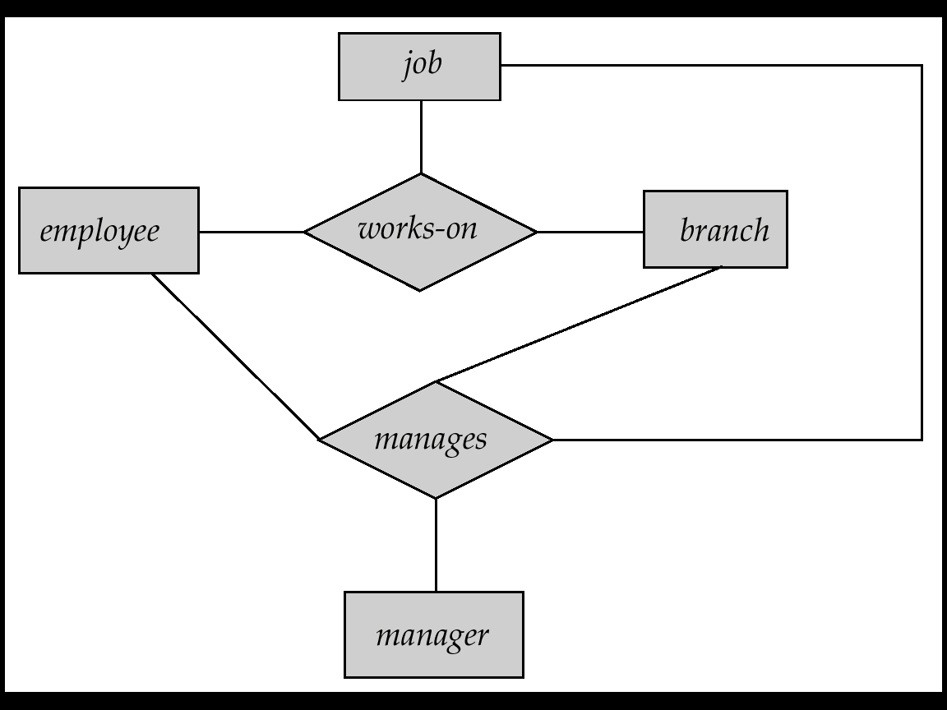
6.7.5 Aggregation
Consider the ternary relationship works-on, which we saw earlier
Suppose we want to record managers for tasks performed by an employee at a branch
6-<number>

Slide 71

E-R Diagram with Aggregation, Fig. 6.22
6-<number>

Slide 72

Symbols in E-R Notation, Fig. 6.23
6.7.6 Alternative E-R Notations
6-<number>

Slide 73
Symbols in E-R Notation (cont.)
6-<number>

Slide 74

Alternative E-R Notations, Fig. 6.24
6-<number>

Slide 75
6.8 Database Design for Banking
In designing a database schema to model a given enterprise
  Using E-R data model
  Some decisions have to make
Among the database designer’s decisions are:
  Whether to use an attribute or an entity set to represent an object (Sec. 6.5.1)
  Whether a real-world concept is best expressed by an entity set or a relationship set. (Sec. 6.5.2)
  Whether to use a ternary relationship versus a pair of binary relationships. (Sec. 6.5.3)
  The use of a strong or weak entity set. (Sec. 6.6)
  The use of specialization/generalization – contributes to modularity in the design. (Sec. 6.7)
  The use of aggregation – can treat the aggregate entity set as a single unit without concern for the details of its internal structure. (Sec. 6.7.5)
A database designer needs a good understanding of the problem to make these decisions
6-<number>

Slide 76
E-R Diagram for a Banking Enterprise
Fig. 6.25
6-<number>

Slide 77
6.9 Reduction to Relational Schemas
Reduction E-R Model to Relational Tables
A database which conforms to an E-R diagram can be represented by a collection of tables.
For each entity set there is a unique table which is assigned the name of the corresponding entity set.
For each relationship set ?
Converting an E-R diagram to a table format is the basis for deriving a relational database design from an E-R diagram.
6-<number>

Slide 78
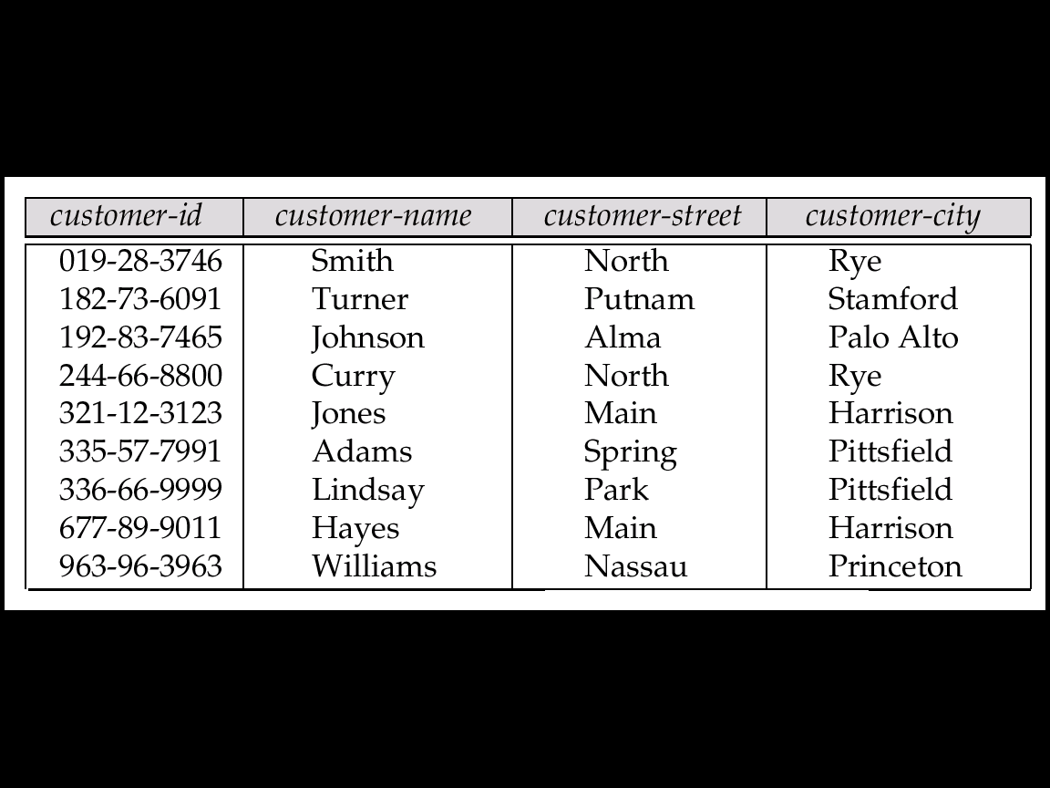
6.9.1 Strong Entity Set ➔ Table
E.g. Consider the strong entity set customer of E-R diagram in Fig. 6.25
  This customer entity set has 4 attributes
➔ corresponding table customer has four columns as follows:
  A strong entity set reduces to a table with the same attributes.
customer
6-<number>

Slide 79
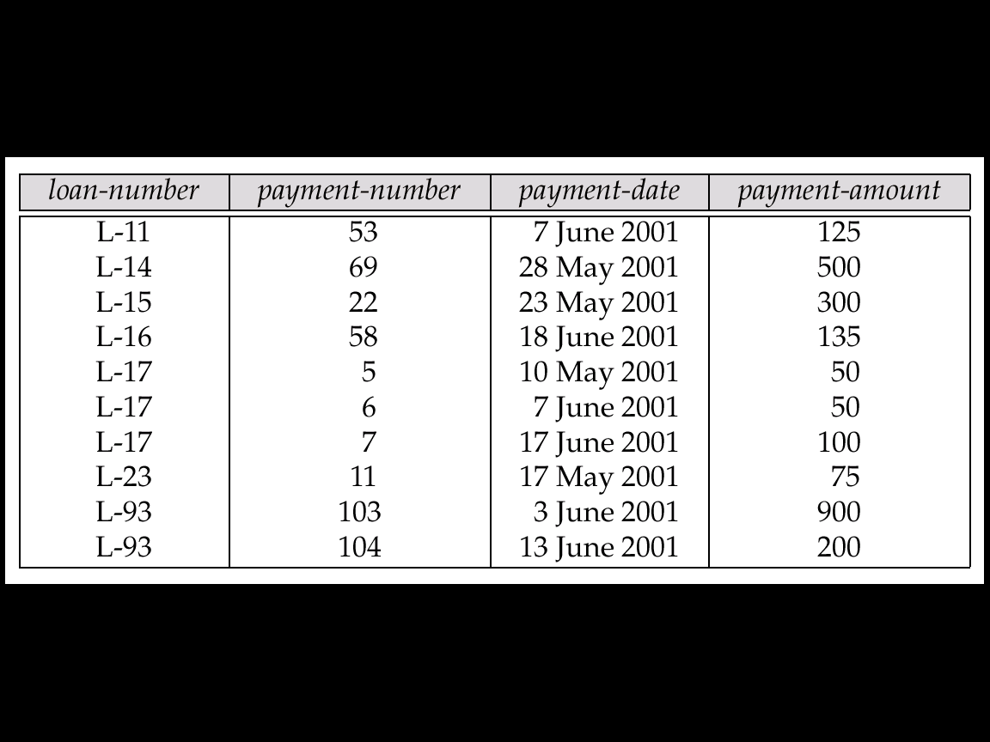
6.9.2 Weak Entity Set ➔ Table
A weak entity set becomes a table that includes a column for the primary key of the identifying strong entity set
E.g. Consider weak entity payment that depends on loan
payment
6-<number>

Slide 80
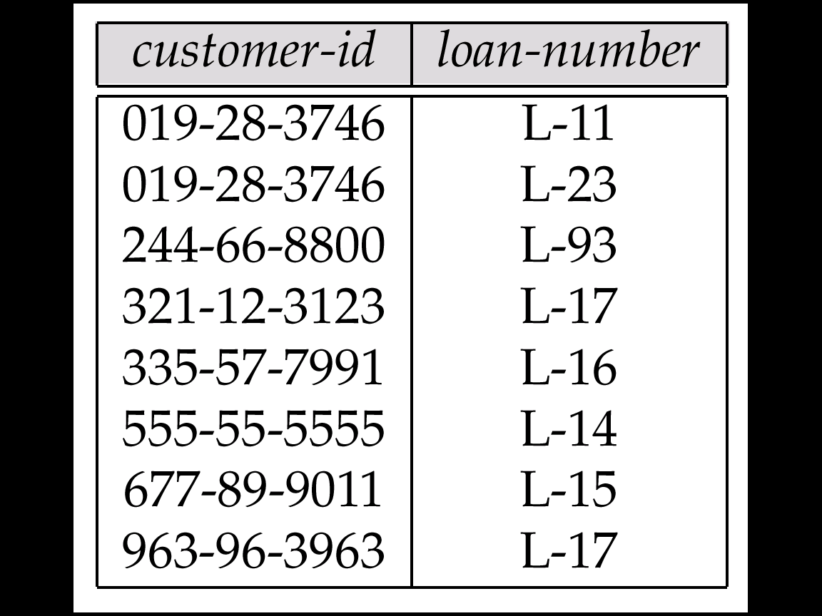
6.9.3 Relationship Sets ➔ Table
?
Case 1: Many-to-Many Relationship Set ➔ Table
A many-to-many relationship set is represented as a table with columns for the primary keys of the two participating entity sets, and any descriptive attributes of the relationship set.
E.g.: table for relationship set borrower
borrower
n
n
6-<number>

Slide 81
6.9.3.1 Redundancy of Schemas
Case 2: Weak Relationship Set ➔ Table
The table corresponding to a relationship set linking a weak entity set to its identifying strong entity set is redundant.
  E.g. The payment table already contains the information that would appear in the loan-payment table (i.e., the columns loan-number and payment-number).
Fig. ??
6-<number>

Slide 82

6.9.3.2 Combination of Schemas
Case 3: Many-to-One/One-to-Many Relationship Set ➔ Table
Many-to-one and one-to-many relationship sets that are total on the many-side can be represented by adding an extra attribute to the many side, containing the primary key of the one side
E.g.: Instead of creating a table for relationship account-branch, add primary key branch-name of branch to the entity set account
Fig. 6.27
account
account-no
balance
branch-name
n
1
many side
one side
6-<number>

Slide 83
Combination of Schemas (cont.)
Case 4: One-to-One Relationship Set ➔ Table
For one-to-one relationship sets, either side can be chosen to act as the “many” side
  That is, extra attribute can be added to either of the tables corresponding to the two entity sets
6-<number>

Slide 84
6.9.4 Composite and Multivalued Attributes
Composite attributes are flattened out by creating a separate attribute for each component attribute
  E.g. given entity set customer with composite attribute name with component attributes first-name and last-name the table corresponding to the entity set has two attributes
  name.first-name and name.last-name
first-name
last-name
customer
name
first-name
last-name
…
customer
6-<number>

Slide 85
Multivalued Attributes
A multivalued attribute M of an entity E is represented by a separate table T
  Table T has attributes corresponding to the primary key of E and an attribute corresponding to multivalued attribute M
  E.g. Multivalued attribute dependent-names of employee is represented by a table
  employee-dependent-names( employee-id, dname)
  Each value of the multivalued attribute maps to a separate row of the table T
    E.g., An employee entity with primary key: John
    dependents: Johnson and Johnkid
    maps to two rows:
    (John, Johnson)
    (John, Johnkid)
employee-dependent-names
employee-id dname
John Johnson
John Johnkid
6-<number>

Slide 86
6.9.5 Generalization ➔ Table
Consider Fig. 6.25, p.240 or next slide ↘
  savings-account ISA account
  checking-account ISA account
Method 1:
  Form a table for the higher level entity
  Form a table for each lower level entity set, include primary key of higher level entity set and local attributes
  E.g
    account( account-number, balance)
    savings-account(account-number, interest-rate)
    checking-account(account-number, overdraft-amount)
6-<number>

Slide 87
E-R Diagram for a Banking Enterprise
Fig. 6.25
6-<number>

Slide 88
Generalization ➔ Table (cont.)
Method 2:
  If the generalization is disjoint不相交 and complete
  Form a table for each entity set with all local and inherited attributes
  E.g
    savings-account(account-number, balance, interest-rate)
    checking-account(account-number, balance, overdraft-amount)
  Note 1: An overlapping generalization (not disjoint)
    balance will store twice, redundancy
  Note 2: Not complete
    Some account were neither savings nor checking accounts
    Can not use Method 2
6-<number>

Slide 89
6.9.6 Aggregation ➔ Table
E.g. To represent aggregation manages between relationship works-on and entity set manager, create a table
manages(employee-id, branch-name, title, manager-name)
  Includes each primary key
  Any attributes of manages, if they exist
title
employee-id
branch-name
manager-name
6-<number>

Slide 90
Homework
6-<number>

Slide 91
6.11 UML **
UML: Unified Modeling Language
UML has many components to graphically model different aspects of an entire software system
  Class Diagram
  Use Case Diagram: show the steps of tasks that users perform
  Activity Diagram: depict the flow of tasks between various components of a system
  Implementation Diagram:
UML Class Diagrams correspond to E-R Diagram, but several differences.
6-<number>

Slide 92
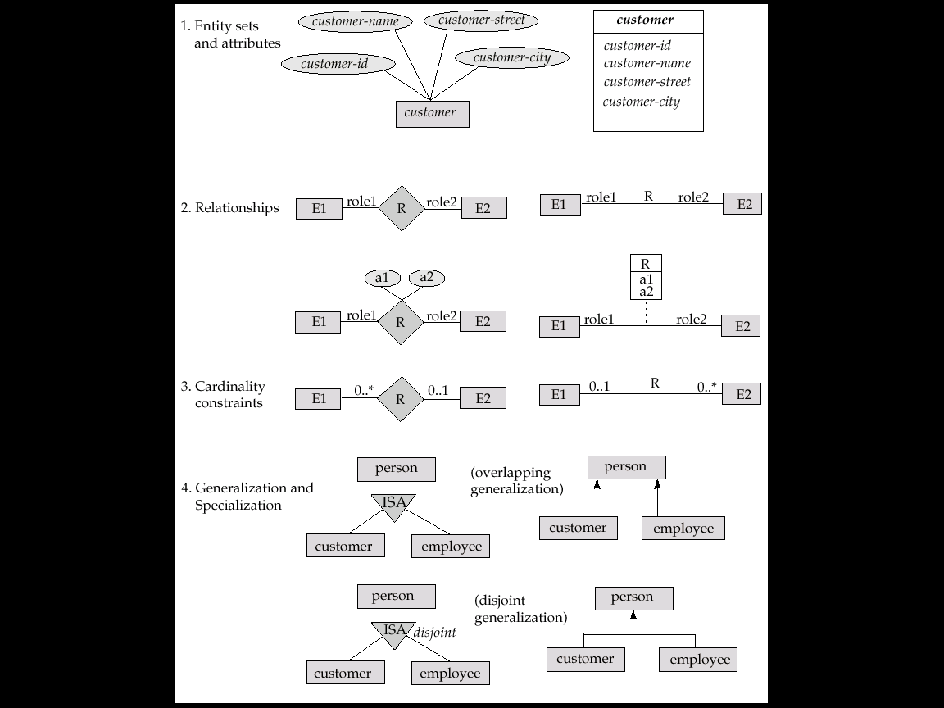
E-R Diagram vs. UML Diagram, Fig. 6.28
E-R Diagram UML diagram
6-<number>

Slide 93
E-R Diagram vs. UML Diagram, Fig. 6.28 (cont.)
E-R Diagram UML diagram
6-<number>

Slide 94
Phase II: Stop Here
6-<number>

